Slide 1
Personal UPI Usage and Financial Analyzer using LLMs
Avalan R
10/07/2025
AI-powered UPI statement processing and financial recommendation system.

Slide 2
THE PROBLEM 1. People use multiple UPI apps (Paytm, GPay,PhonePe). 2. Difficult to track and understand spending. 3. No unified, intelligent advice from all platforms. SOLUTION 1. Automate extraction, categorization and summarization 2. Generate Personalized budget recommendations busing LLMs

Slide 3
Pipeline Overview
PDF Extraction (pdfplumber)
Data Cleaning (pandas)
Categorization (Keywords in Remarks)
Summarization (Monthly totals, categories, merchants)
LLM Advice (huggingface_hub , gradio_client)
Interface (gradio on Hugging Face Spaces)

Slide 4
Tech Stack
Python, pandas, pdfplumber
Gradio
Hugging Face Transformers
Langflow(conceptual pipeline)
Key Features
Modular code (extract.py, process.py, analyze.py)
Reusable LLM call functions
Clean PEP8- compliant scripts

Slide 5
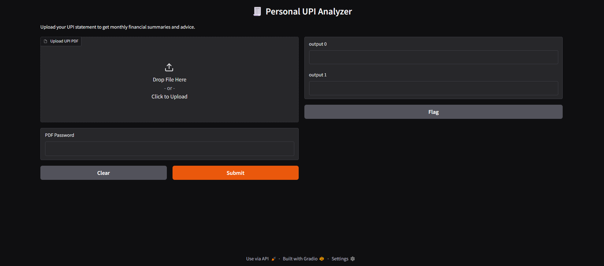
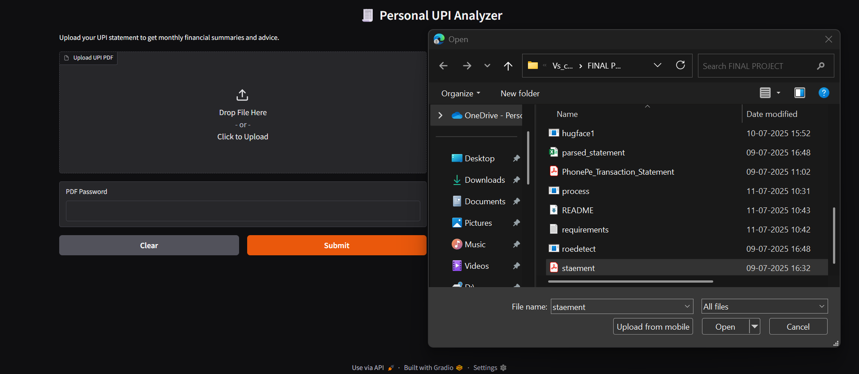
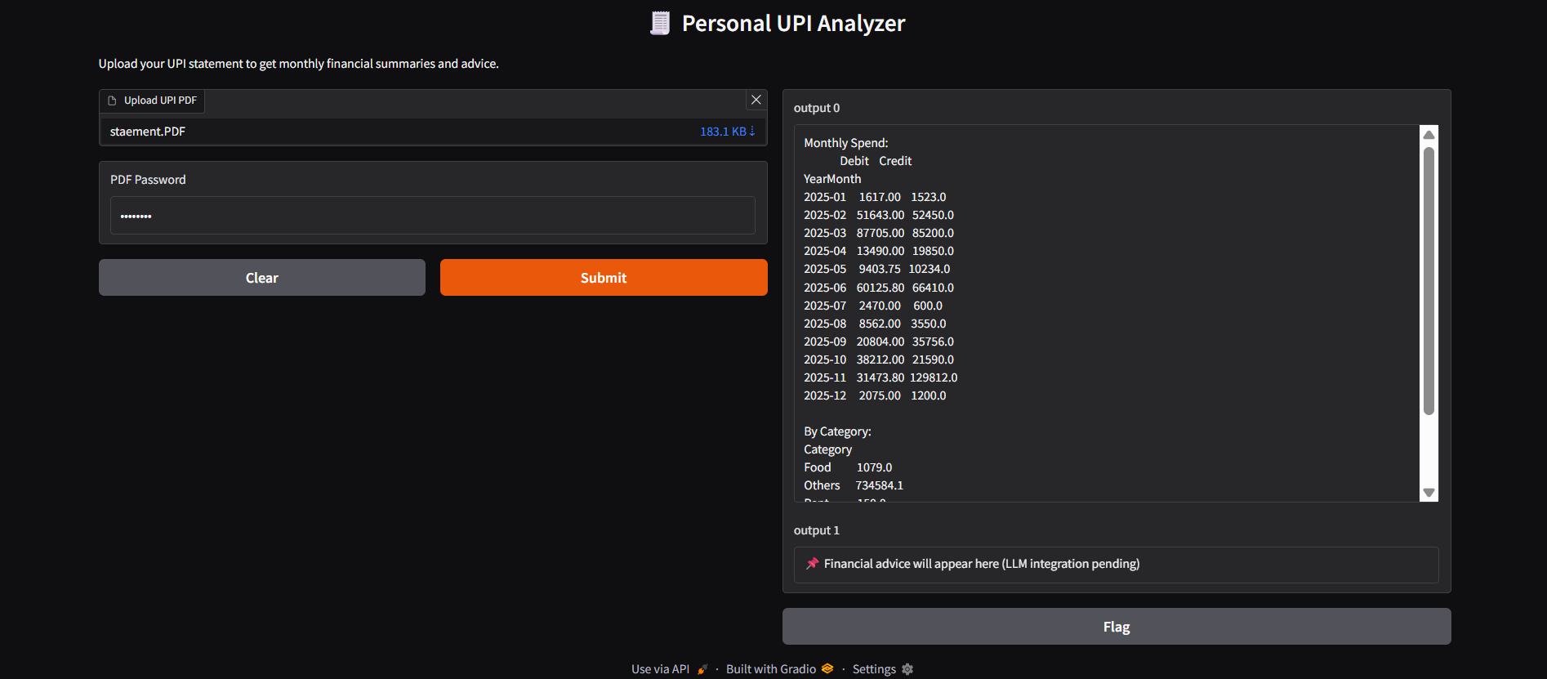
RESULTS & SCREENSHOTS

Slide 6
Interactive visual dashboards User Authentication More advanced categorization ( NER models )
FUTURE ENHANCEMENTS

